Slide 1


TextSummarization ChatBot

Slide 2
Problem Statement & Solution
Problem Statement:
Develop an AI chatbot to produce concise text summaries from voluminous content, refining its results using real-time user feedback, and ensuring adaptability for diverse content genres, to enhance user experience and information absorption.
Solution:
This solution focuses on crafting an AI chatbot skilled in producing concise text summaries from extensive content. By leveraging advanced NLP techniques and iterative learning, the chatbot not only generates summaries but also refines its outputs through real-time user feedback. By seamlessly integrating automated text summarization with human-guided corrections, the chatbot stands out as an efficient tool for enhancing information consumption and user experience.
Steps Involved:
Environment Setup
Reward Design
Defining Summarization Environment
Q-Learning Agent Setup
Initialize Summarization Pipeline
Feedback based Fine-Tuning
Training Loop Setup
Evaluation and Testing

Slide 3






Use case – Process Flow
Text Summarization ChatBot
User provides text
Model generates Initial Summary
User provides Feedback
Model refines Summary based on Feedback

Slide 4
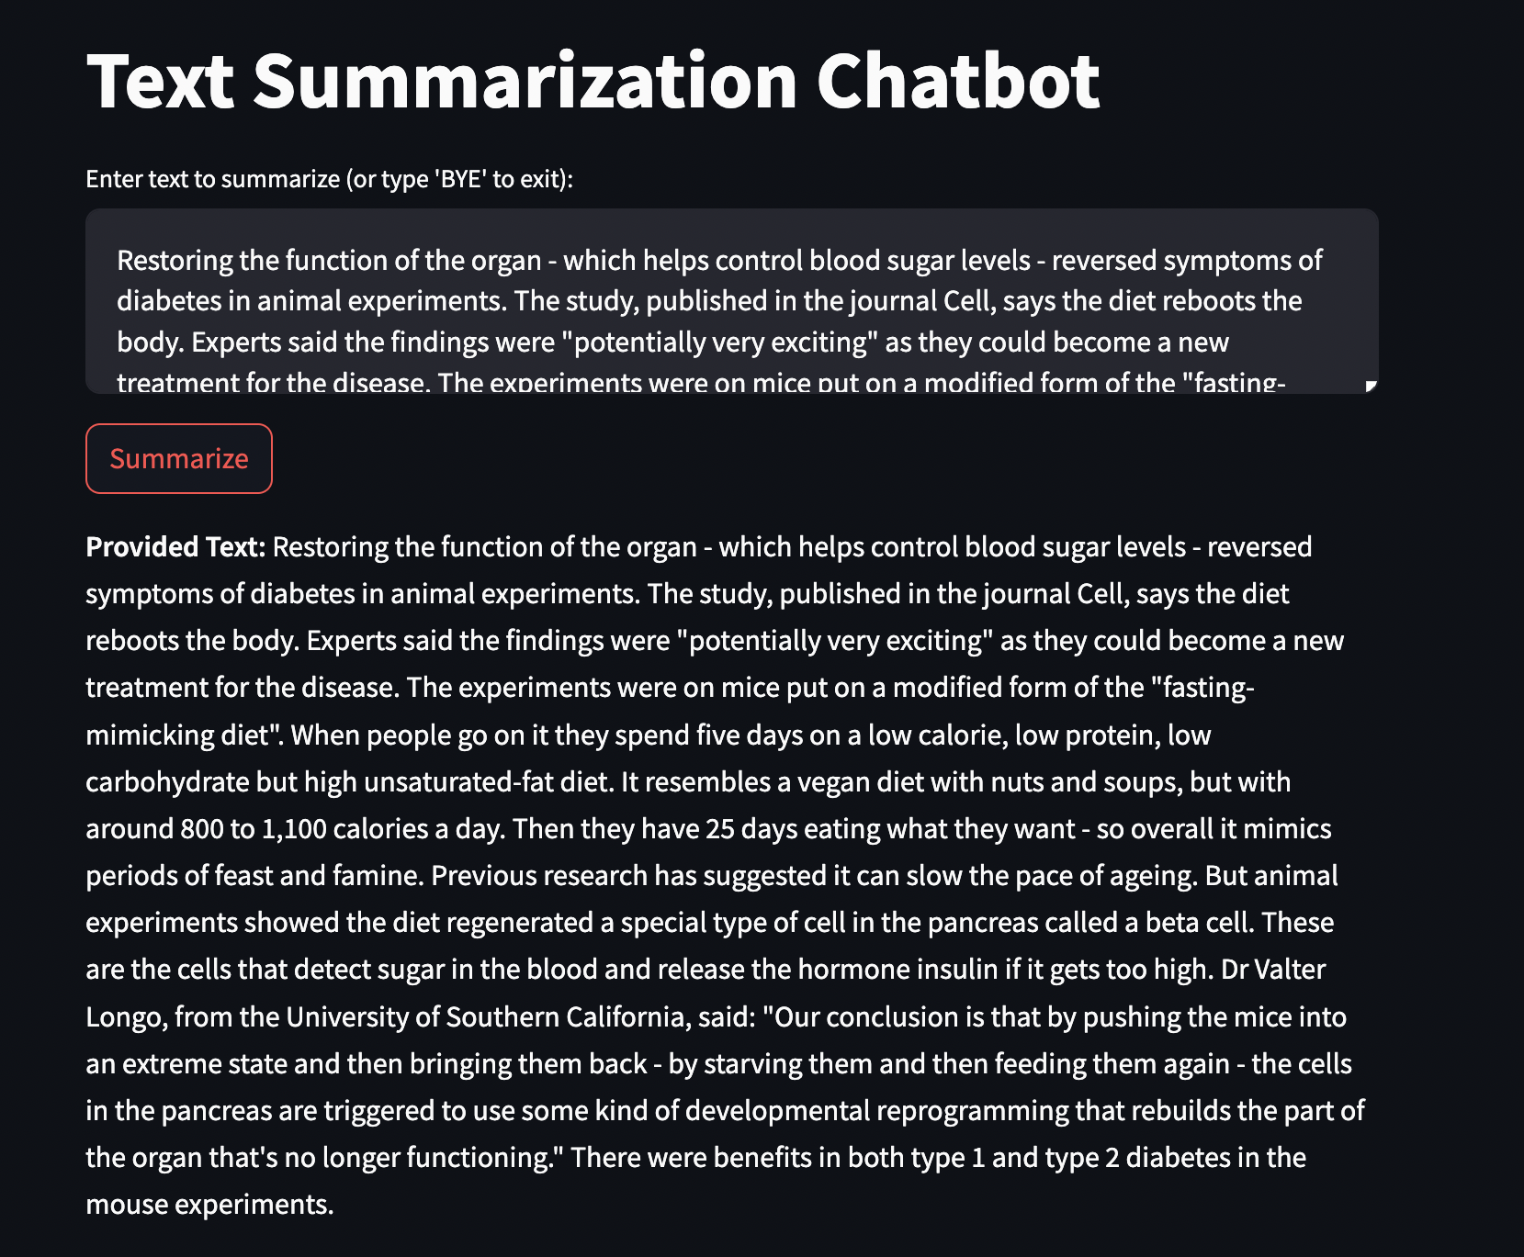
Results
Taking input of the Text to Summarize:

Slide 5
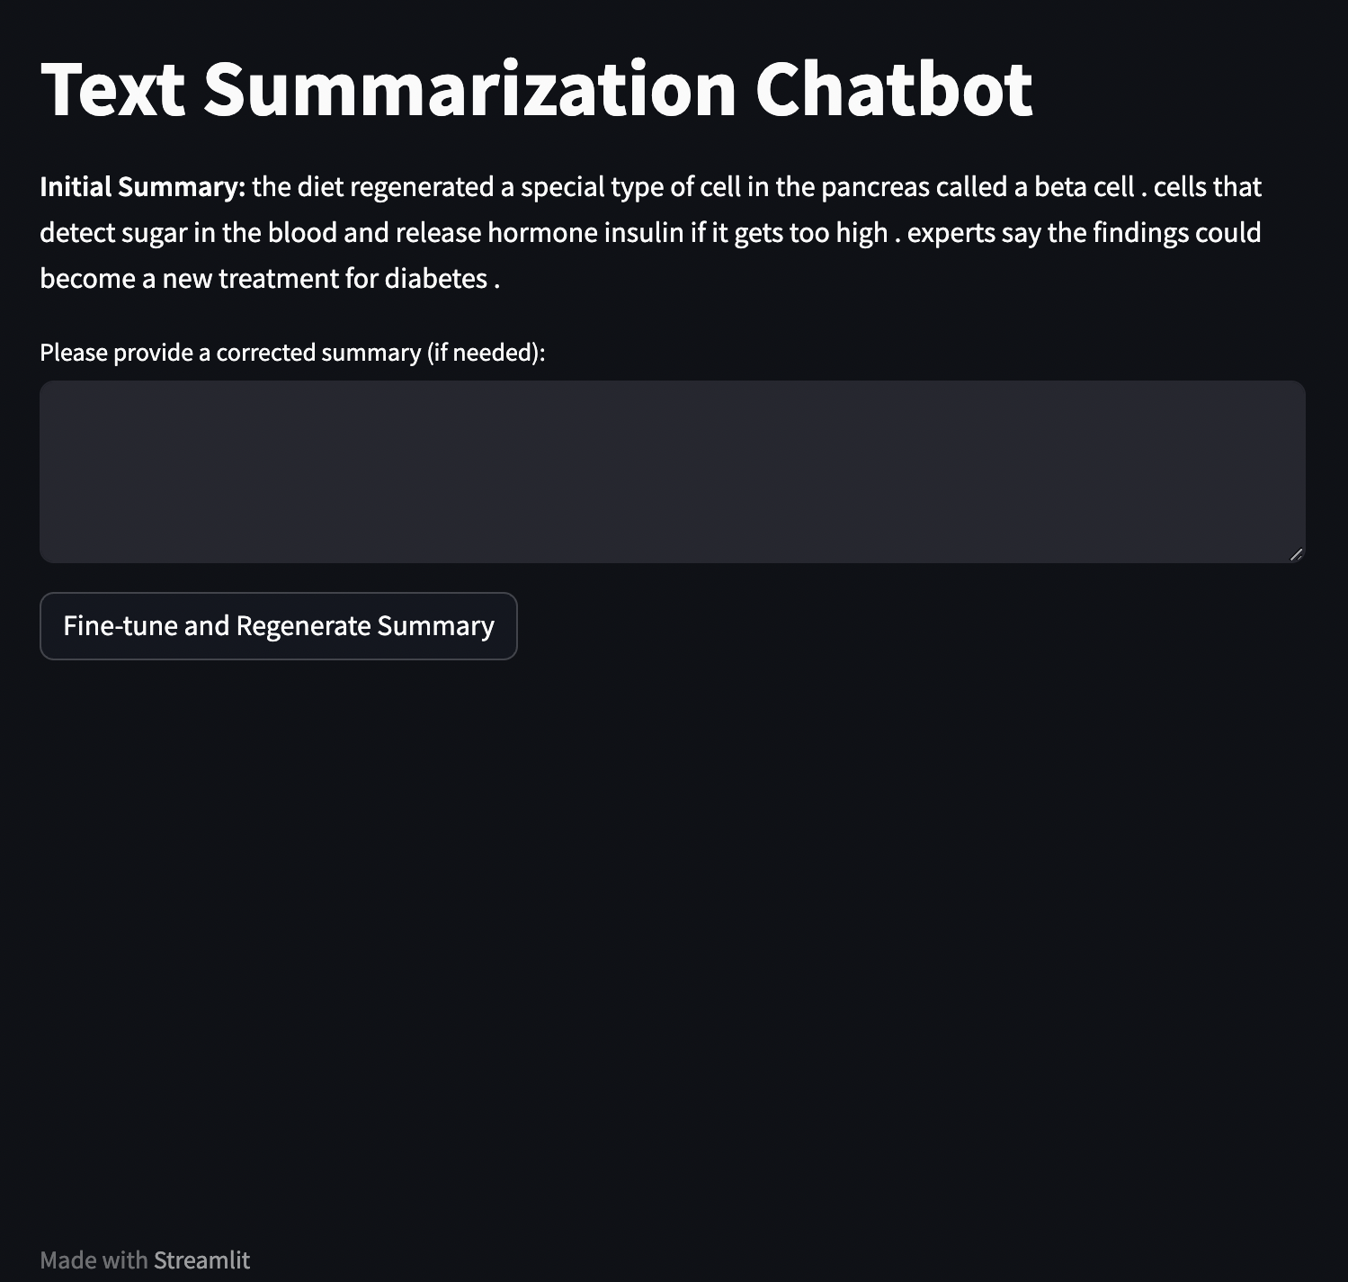
Results
Generating the initial Summary:

Slide 6
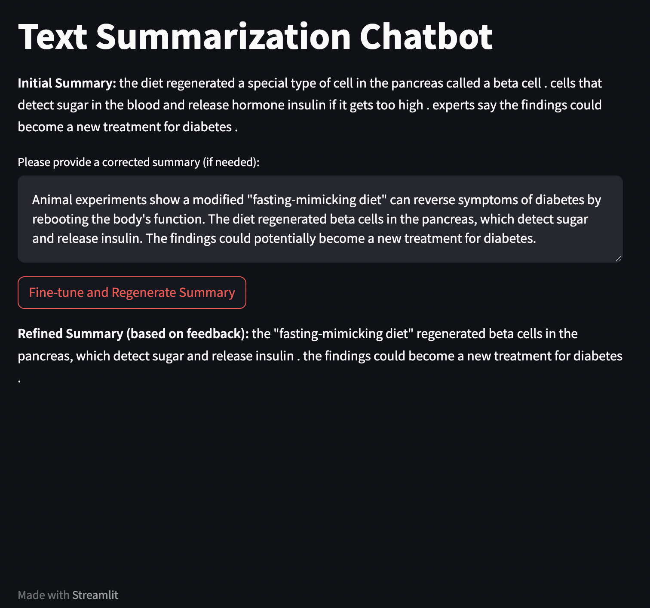
Results
Providing Feedback and Regenerating the summary based on the Feedback:

Slide 7
Benefits
By incorporating real-time human feedback into the summarization process, it's possible to produce results that are more in line with human expectations and specific requirements.
The model can continuously adapt based on new feedback, ensuring that it remains up-to-date with user preferences and the evolving nature of the data.
Industries often deal with large volumes of textual data daily. Quick summarizations can save hours of reading, translating to significant time savings.
For movie buffs or book lovers, they can get quick summaries of plots, reviews, or related content.
Future Work
Adapt the model to be proficient in summarizing niche topics or industries such as medical journals, legal documents, or scientific papers.
Train the Text Summarization chatbot to handle and produce summaries in multiple languages, catering to a global audience.
Integrating the bot with Voice Assistants for accessibility, basically making it inclusive for everyone.

Slide 8
THANKS!
K SRIKAR
srikar.k@criticalriver.com

